Slide 1
Identification of issues related to WRM in Montenegro
Goran Sekulić
University of Montenegro , Faculty of Civil Engineering
Vienna / 8th May 2019
This project has been funded with support from the European Commission. This publication reflects the views only of the author, and the Commission cannot be held responsible for any use which may be made of the information contained therein.

Slide 2
INTRODUCTION
Montenegro has sufficient water resources, but they are unevenly distributed across the country. (43 l/s·km² )
Ninety-five percent of Montenegrin watercourses are formed within the country. This minimizes cross-border impacts on Montenegrin waters, but also engenders responsibility for the quality and distribution of water, which then flows into neighboring countries.
Rainfall in Montenegro is characterized by high variability in time and space.
The country has good quality groundwater and surface water, but these resources are unevenly distributed throughout the country.
Strengthening of master curricula in water resources management
for the Western Balkans HEIs and stakeholders
www.swarm.ni.ac.rs

Slide 3
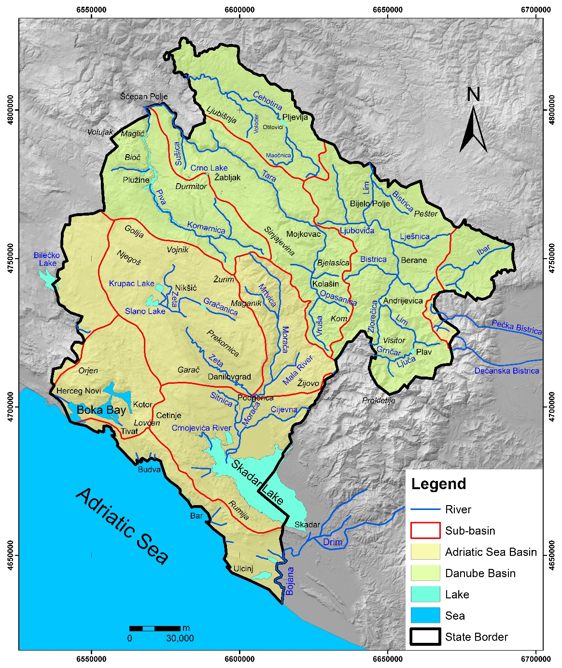
About half the country belongs to the Danube catchment and the other half to the Adriatic catchment.
Karst areas in the central and western parts are arid, whereas the northern mountainous area is richer in raw water
The southern parts of the country are likely to be most vulnerable to climate change.
Strengthening of master curricula in water resources management
for the Western Balkans HEIs and stakeholders
www.swarm.ni.ac.rs

Slide 4
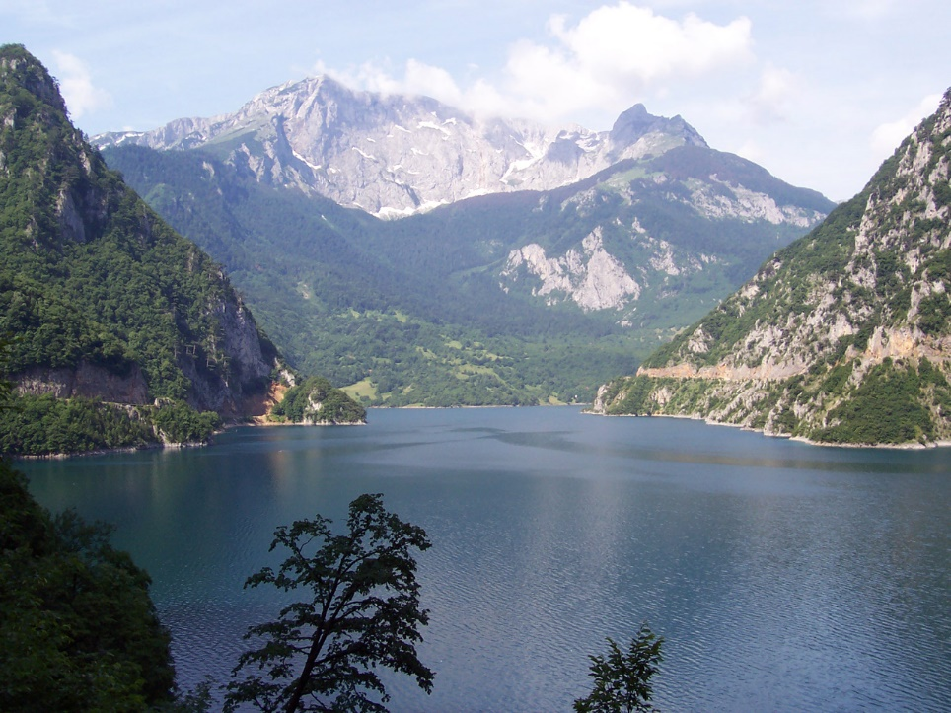
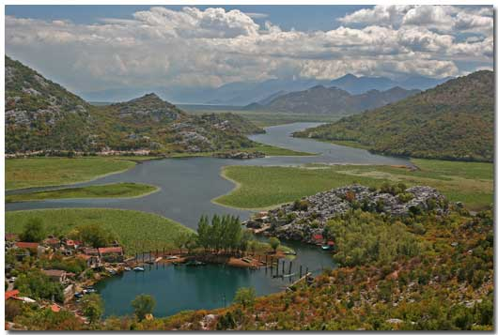
The most beautiful water surfaces are the river Tara with its UNESCO protected canyon, canyons of the Piva and the Morača, Skadar Lake as the biggest in Balkans and numerous lakes, especially mountain – glacial lakes (Crno Lake, Biogradsko Lake etc.) as a natural rarity and a magnificent natural beauty.
Strengthening of master curricula in water resources management
for the Western Balkans HEIs and stakeholders
www.swarm.ni.ac.rs

Slide 5
The position of Montenegro along the south coast of Adriatic Sea has a specific influence on precipitation regime, with precipitation on some locations among the highest in Europe (over 4500 mm of precipitate annually).
Precipitations in Montenegro form approximately totally 14 billion m3 of annual precipitation.
In spite of plenty of precipitation on its spacious limestone terrains, there is a lack of surface water and abundance of ground water. That is why on relatively small distance we have both richness and lack of water, as almost nowhere in the world.
Strengthening of master curricula in water resources management
for the Western Balkans HEIs and stakeholders
www.swarm.ni.ac.rs

Slide 6
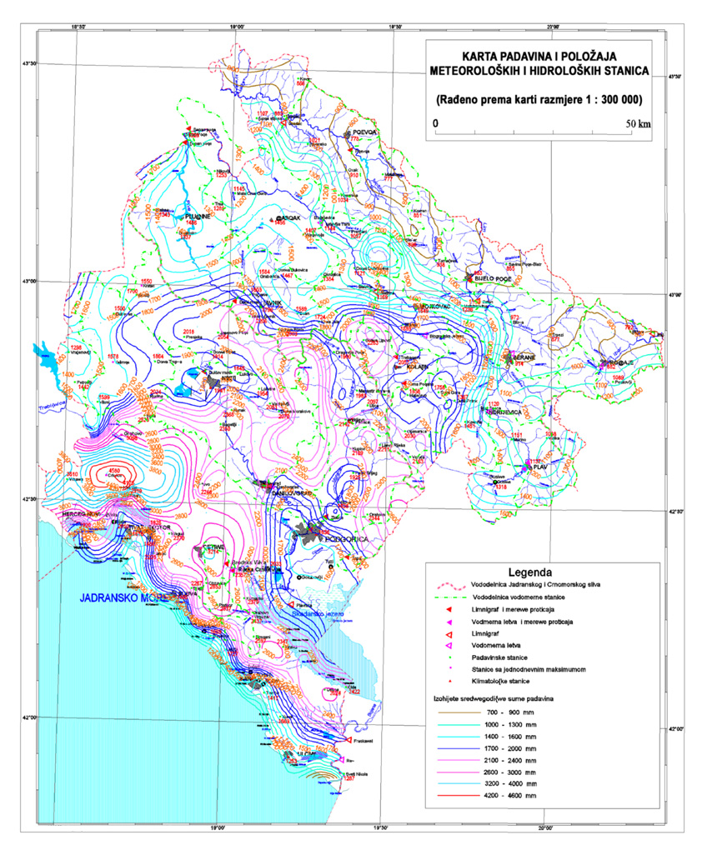
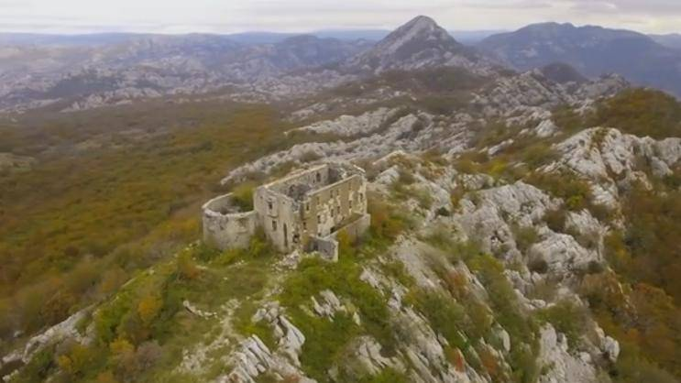
Crkvice
over 4500 mm of precipitate annually
Strengthening of master curricula in water resources management
for the Western Balkans HEIs and stakeholders
www.swarm.ni.ac.rs

Slide 7
Identify problems and challenges
Protecting water as a vulnerable resource, groundwater resources
Increasing the public understanding of the water sector, hydro power using
Growing impact of climate change on water
Increasing the resource efficiency in the water sector
Setting the right price for water services
Managing long term assets in a fast changing environment
Strengthening of master curricula in water resources management
for the Western Balkans HEIs and stakeholders
www.swarm.ni.ac.rs

Slide 8


Policy, Strategic Planning and Legal Framework
Relevant water legislation in Montenegro consists of regulations of interior right passed by its competent authorities, related to water management
The Ministry of Agriculture and Rural Development is the main body responsible for development of water policy. It has a functional unit named the Water Administration that is responsible for implementation of water legislation, including management of water infrastructure, protection from the harmful effects of water, protection of water from pollution, establishment and maintenance of a water information system, delimitation of water resources and water permitting (both water use and effluent discharge).
Strengthening of master curricula in water resources management
for the Western Balkans HEIs and stakeholders
www.swarm.ni.ac.rs

Slide 9
The Ministry of Sustainable Development and Tourism is responsible for environmental policy, and encompasses the Directorate of Waste Management and Communal Development that is responsible for proposing, tracking and directing policies in the area of plans and programmes related to urban water supply and wastewater treatment, and monitoring the implementation of the adopted long-term development plans and action plans.
The Public Health Institute under the Ministry of Health is responsible for the quality control of drinking water in terms of human health and safety, including the quality of surface water and bathing waters.
The Ministry of Economy is responsible for water tariffs and participates in the procedures for concession of some water rights.
The Ministry of Transport and Maritime Affairs performs administrative tasks related to maritime traffic and safety,, the prevention of and emergency in the event of sea pollution, and the control of dangerous goods transportation in maritime and inland navigation.
The Ministry of the Interior is responsible for risk management and emergency situations response, including in the event of floods.
Strengthening of master curricula in water resources management
for the Western Balkans HEIs and stakeholders
www.swarm.ni.ac.rs

Slide 10
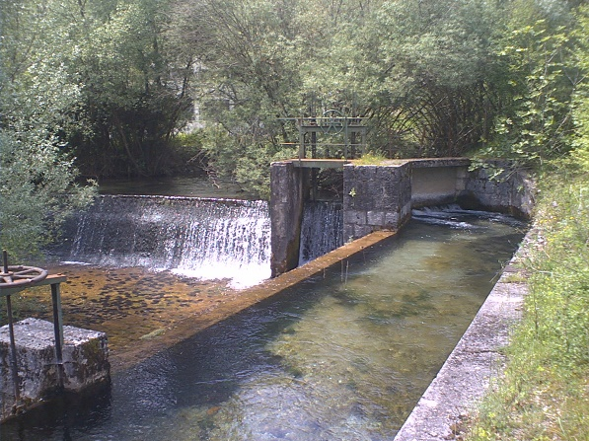
Policy, Strategic Planning and Legal Framework
Main national instruments for water resources management
Strengthening of master curricula in water resources management
for the Western Balkans HEIs and stakeholders
www.swarm.ni.ac.rs

Slide 11
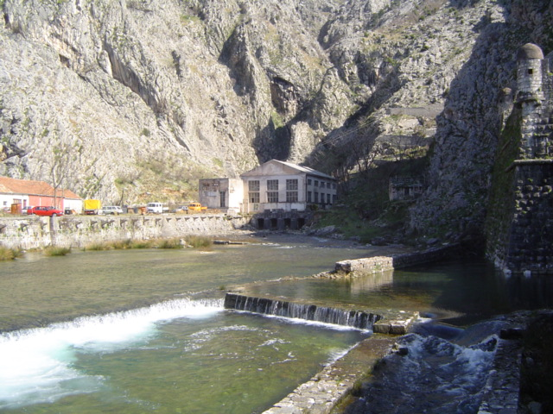
Governance and Institutional Frameworks
Capacity building for water resources management
Strengthening of master curricula in water resources management
for the Western Balkans HEIs and stakeholders
www.swarm.ni.ac.rs

Slide 12
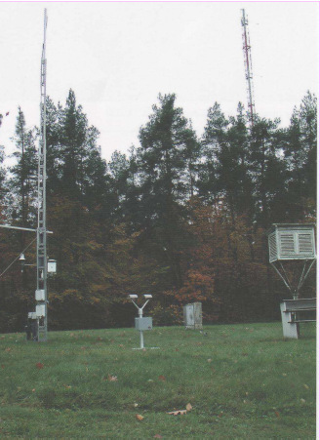
Management Instruments
Monitoring and information management
Strengthening of master curricula in water resources management
for the Western Balkans HEIs and stakeholders
www.swarm.ni.ac.rs

Slide 13
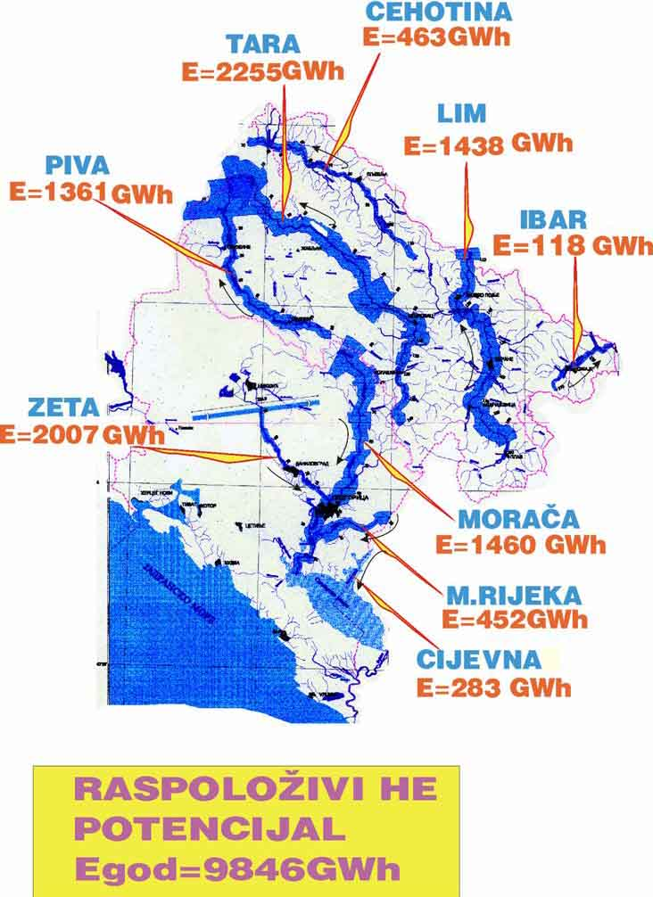
Infrastructure Development and Financing
Investment plans and programs for different water sectors
Strengthening of master curricula in water resources management
for the Western Balkans HEIs and stakeholders
www.swarm.ni.ac.rs

Slide 14

Sources of Financing for the Development of Water Resources
Sources of financing for the development of water resources
Strengthening of master curricula in water resources management
for the Western Balkans HEIs and stakeholders
www.swarm.ni.ac.rs

Slide 15
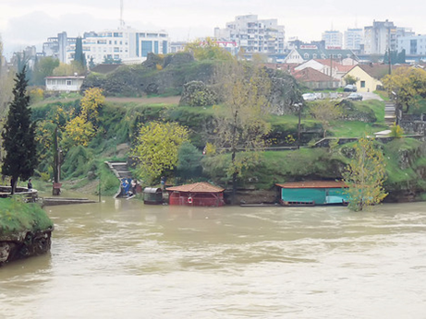
Outcomes and Impacts
The overall national development impact in past 20years
Strengthening of master curricula in water resources management
for the Western Balkans HEIs and stakeholders
www.swarm.ni.ac.rs

Slide 16
Priority challenges
Priority water resources challenge areas – Current challenge level
Strengthening of master curricula in water resources management
for the Western Balkans HEIs and stakeholders
www.swarm.ni.ac.rs

Slide 17
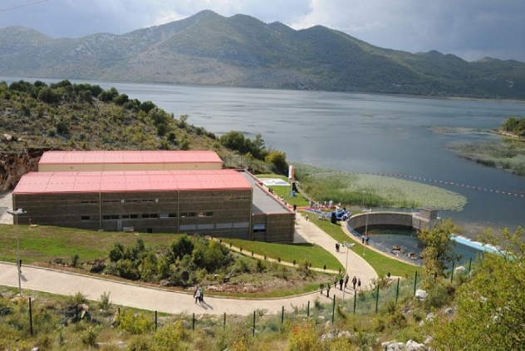
Priority water resources challenge areas – In the past 20 years,
Strengthening of master curricula in water resources management
for the Western Balkans HEIs and stakeholders
www.swarm.ni.ac.rs

Slide 18
Priority water management challenge areas – Current challenge level
Strengthening of master curricula in water resources management
for the Western Balkans HEIs and stakeholders
www.swarm.ni.ac.rs

Slide 19
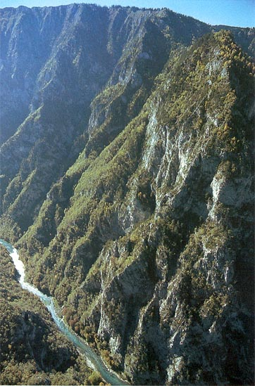
Priority water management challenge areas – In the past 20 years,
Strengthening of master curricula in water resources management
for the Western Balkans HEIs and stakeholders
www.swarm.ni.ac.rs

Slide 20
Strengthening of master curricula in water resources management
for the Western Balkans HEIs and stakeholders
www.swarm.ni.ac.rs

Slide 21
Strengthening of master curricula in water resources management
for the Western Balkans HEIs and stakeholders
www.swarm.ni.ac.rs

Slide 22
The EU Water Framework Directive 2000/60/EC has been the main driver for the evolution of the legal framework in Montenegro regarding water resources management and water services, providing the foundations for the Law on Water and associated draft amendments.
The 2001 Water Master Plan for the period 2001– 2011 expired but is still applied.
According to the Law on Water, the Government should develop and adopt a water master plan for the whole country and water management plans for each river basin district, or for parts of a river basin district, by 2016. Subsequently, the Government has to adopt a programme of measures for each river basin district. However, in the process of negotiations with EU it was agreed to prolong deadline for this activity and insure financial resources through IPA 2014-2020 programme.
Strengthening of master curricula in water resources management
for the Western Balkans HEIs and stakeholders
www.swarm.ni.ac.rs

Slide 23
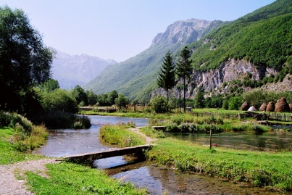
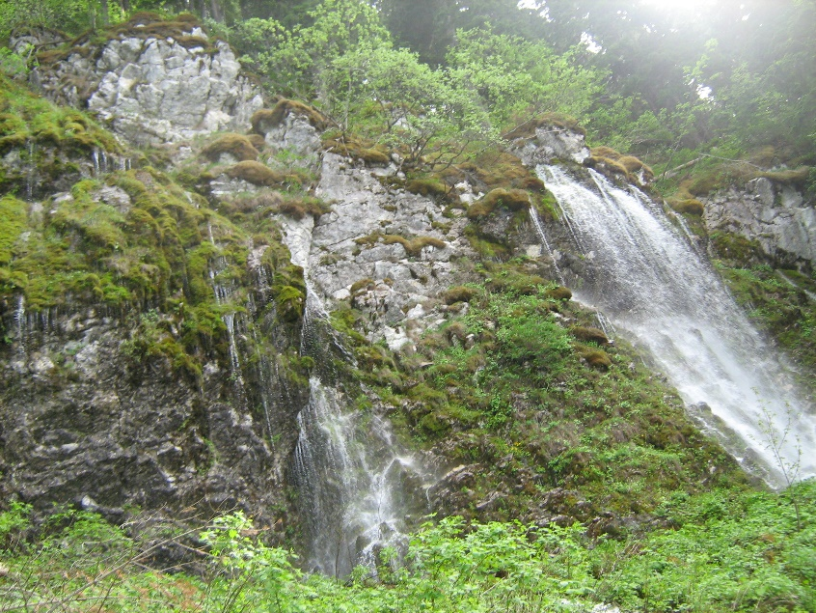
Among other issues, the Law on Water points to an integrated management based on river basin approach and regulates ownership on water, water management planning, water regulation and use, water infrastructure, water monitoring, protection against floods and erosion.
Strengthening of master curricula in water resources management
for the Western Balkans HEIs and stakeholders
www.swarm.ni.ac.rs

Slide 24

The End
Strengthening of master curricula in water resources management
for the Western Balkans HEIs and stakeholders
www.swarm.ni.ac.rs

Slide 25

Strengthening of master curricula in water resources management
for the Western Balkans HEIs and stakeholders
www.swarm.ni.ac.rs

